Slide 1

NATIONAL INSTITUTE OF TECHNOLOGY DELHI
राष्ट्रीय प्रौद्योगिकी संस्थान दिल्ली
Department of Mechanical Engineering
Project title :- Performance Analysis of Connecting Rod
Given By-
AJAY PANCHAL 221310005
AKSHAR SINGH 221310008
AMAN GAUTAM 221310009
ARJUN KUMAR 221310012
Project Supervisor:- Dr. Chitragupt Swaroop Chitransh

Slide 2
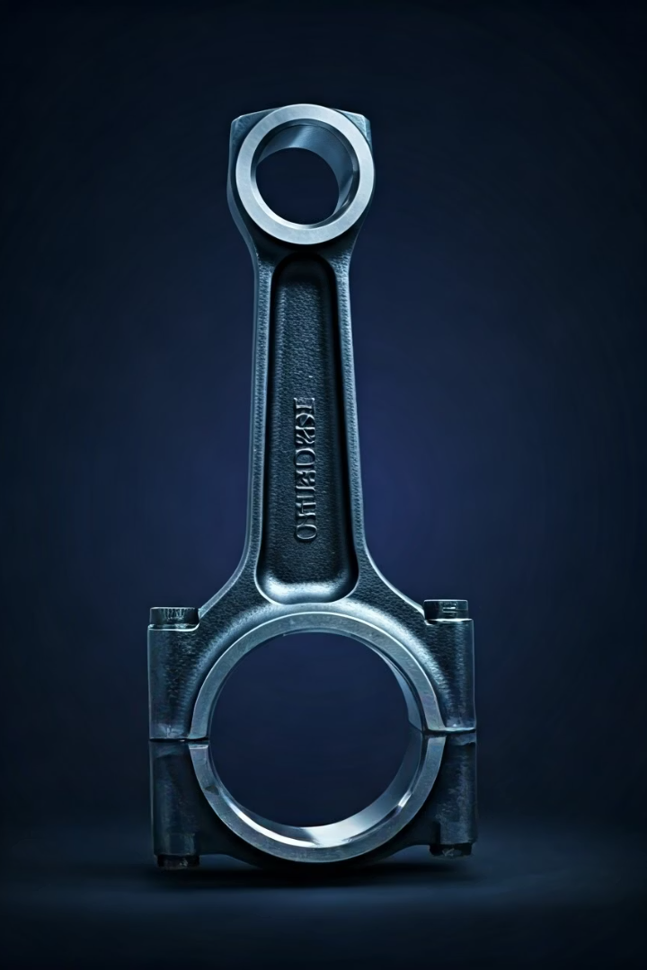
.
Introduction
The connecting rod is a critical component in IC engines, transmitting force from the piston to crank shaft
Traditionally manufactured from cast iron due to its good damping
properties and ease of casting
However, cast iron presents limitations in strength-to-weight ratio and fatigue resistance.
This study investigates the performance implications of replacing cast iron with carbon steel—a material known for its superior tensile strength, toughness, and fatigue life.

Slide 3
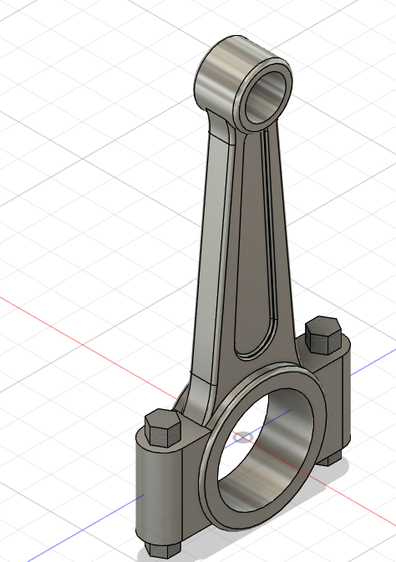
Connecting rod specifications
Crankshaft radius 48.5 mm
Connecting rod length 141.014 mm
Piston diameter 86 mm
Mass of the piston assembly 0.434 kg
Mass of the connecting rod 0.439 kg
Izz about the center of gravity 0.00144 kg m2
Distance of C.G. from crank end center 36.44 mm

Slide 4
Material assignment
Carbon steel AISI -1045
Parameter | Carbon steel AISI 1045 | Cast Iron values
Composition | 0.4 % C ,98.5% Fe, 0.6% Mn, 0.09% S,P | 2-2.65% c,0.90% S,0.25%Mn,97.2 %Fe
Density | 7.88 g/cc | 7.1 g/cc
Tensile strength, Ultimate | 565 MPa | 200 Mpa
Tensile strength, Yield | 310 MPa | 130 MPa
Modulus of elasticity | 200GPa | 100-130GPa
Endurance limit | 270-300 MPa | 70-140 MPa
Poissons Ratio | 0.29 | 0.21
Stress vs strain curve
of carbon steel AISI 1045

Slide 5
Calculations :-
Pressure calculation for 150 cc engine
Engine type – Air cooled 4 stroke engine
Bore * stroke = 57*58.6
Displacement = 149.5cc
Max. Power= 13.8 bhp at 8500rpm
Max. Torque= 13.4 Nm at6000rpm
Compression ratio = 9.35/1
Density of Petrol= 737.22 kg/m3
Temperature = 288.85 k
Mass = Density × Volume = 0.11Kg
Molecular Weight of Petrol= 114.228 g/mole
Forces calculation
i). Force due to gas pressure
Maximum force due to gas pressure,
Fa = (π x d2 x Pe) / 4
= (3.14 x 1002 x 3.15) / 4 = 24,740N

Slide 6
ii). Inertia force due to reciprocating mass
Fi = M x ω2 x r x (cosӨ + (r x cosӨ) / l)
= 2.25 x (2 x 3.14 x 1800)2 x 22 x (cos0 + (22 x cos0) / 380)
= 1756N
iii). Frictional force
The force of friction due to piston rings and piston is,
Ff = h x π x d x i x pr x μ
=635.23 x 3.14 x 100 x 3 x 0.137 x 0.05
= 4099N
iv). Force acting on piston
F = Fgas + Finertia - Ffriction
= 24,740+1756-4099
=22,397N
V). Force acting on connecting rod
Fc = F / cosβ [At top dead center β=0]
=22,397 / cos0
= 22,397 N
Pressure on connecting rod = Force / area = 432 MPa

Slide 7
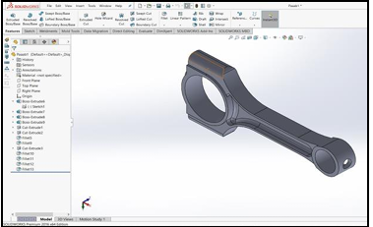
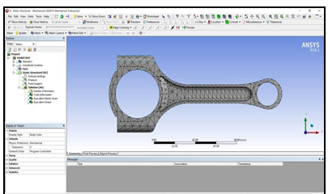
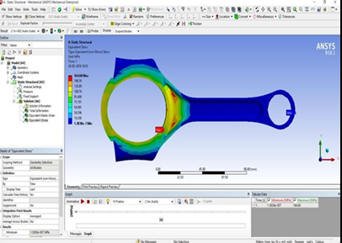
Solid model of connecting rod
Meshing of the connecting rod
Equivalent stress of carbon steel

Slide 8




Analysis and Results
Carbon steel AISI 1045 is far better than cast iron due to given advantages for connecting rod in different vehicles.
Life cycle
High impact resistance
1
Life cycle is more due to more endurance limit of carbon steel.
Due to high tensile strength of Carbon steel.
2
Dimensional Stability
4
Corrosion resistance
Since carbon steel is more durable and has high thermal stress bearing capacity
3
High carbon percentage in cast iron reduces the corrosion resistance.

Slide 9


Conclusion
This overview research report studies the possibilities of Strength enhancement and life cycle in forged steel connecting rod. For increasing life cycle, Endurance limit was considered as a Consequential factor. First, the connecting rod was 3D modelled. After that load analysis was performed using ABAQUS software, these useful insights were drawn
From the mentioned work it is clear that Carbon steel alloy is the best for manufacturing of connecting rod. As it has the best Factor of Safety with regard to its weight and minimum deformation with high impact resistance.

Slide 10
References
[1] Suraj pal, Sunil Kumar “Design Evaluation and Optimization of
Connecting Rod Parameters Using FEM” International Journal of
Engineering and Management Research, Vol.-2, Issue-6, December
2012.
[2] G. Naga Malleswara rao “Design Optimization and Analysis of a
Connecting Rod using ANSYS” International Journal of Science and
Research (IJSR),july-2013
[3] K.Sudarshan kumar, K.tirupathi reddy, Syed Altaf Hussain,
“Modelling and analysis of two-wheeler connecting rod” International
journal of modern engineering research, October-2012.
[4] Julee Sahu, Jitendra Jayanth, “Design and analysis of Connecting rod
with Aluminium Alloys Replacing cast iron and steel for Internal
combustion engines with the help of ANSYS”, International journal of
multi-disciplinary research centre December-2015

Slide 11
Thank You !

